Slide 1


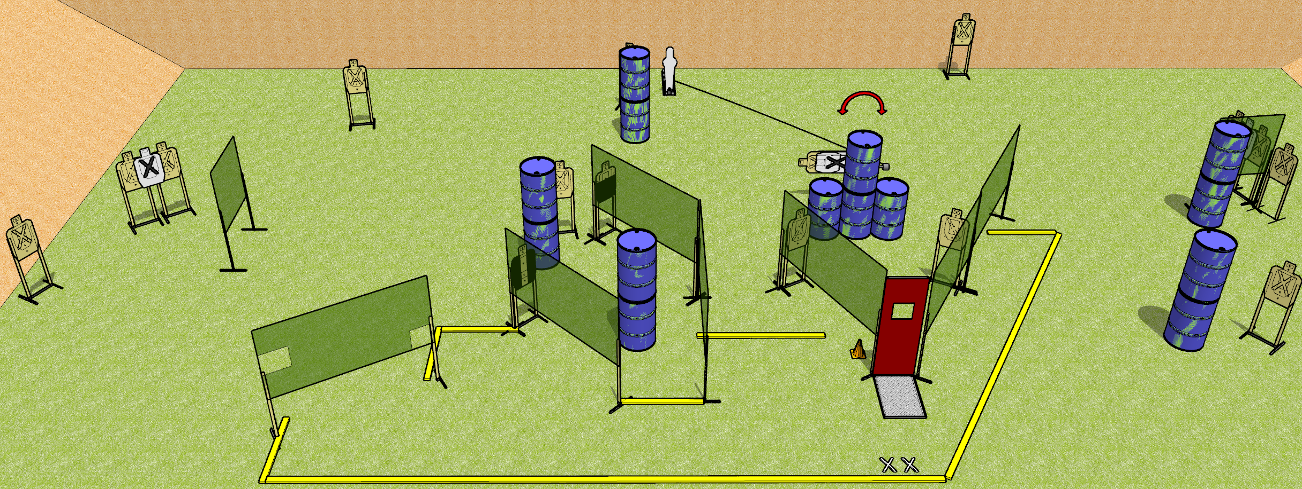
 | Dothan Gun Club – USPSA Match Cruel and Unusual Course Designer : Drew Coleman
START POSITION : Standing with both feet on X’s, wrists below belt
GUN READY CONDITION : Pistol loaded and holstered. PCC loaded, shouldered, safety on, pointed at orange cone. |  | SCORING: Comstock, 31 rounds TARGETS: 15 paper, 1 Steel SCORED HITS: Best 2 on paper, steel until down START-STOP: Audible, last shot RULES:
STAGE PROCEDURE: Engage targets as they become available from within the fault lines.

Slide 2
Cruel and Unusual
Written Stage Briefing
Cruel and Unusual is a 31 round, 155 point, Comstock Field Course. There are fifteen USPSA targets and one pepper popper. The best two hits on paper will score, and steel must fall to score. The start signal is audible.
Handgun start position is standing with both feet on X’s, wrists below belt. Handgun is loaded and holstered.
PCC start position is standing with both feet on X’s, muzzle aimed at orange cone. Carbine is loaded, safety on, held with both hands, shouldered.
Upon start signal, engage the targets as they become available from within the shooting area. The pepper popper activates the swinging target.

